Slide 1
K-means and Hierarchical Clustering
Note to other teachers and users of these slides. Andrew would be delighted if you found this source material useful in giving your own lectures. Feel free to use these slides verbatim, or to modify them to fit your own needs. PowerPoint originals are available. If you make use of a significant portion of these slides in your own lecture, please include this message, or the following link to the source repository of Andrew’s tutorials: http://www.cs.cmu.edu/~awm/tutorials . Comments and corrections gratefully received.
Andrew W. Moore
Professor
School of Computer Science
Carnegie Mellon University
www.cs.cmu.edu/~awm
awm@cs.cmu.edu
412-268-7599
Copyright © 2001, Andrew W. Moore
Nov 16th, 2001

Slide 2
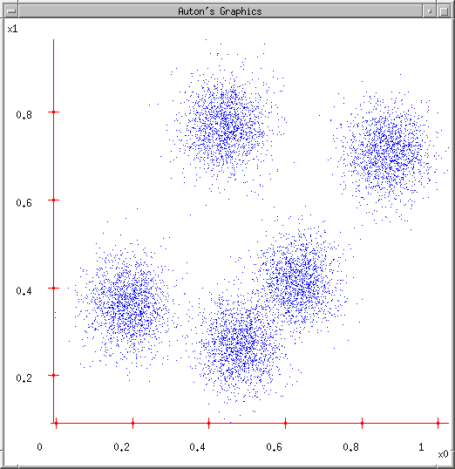
Some Data
This could easily be modeled by a Gaussian Mixture (with 5 components)
But let’s look at an satisfying, friendly and infinitely popular alternative…
Copyright © 2001, 2004, Andrew W. Moore

Slide 3
Lossy Compression
Suppose you transmit the coordinates of points drawn randomly from this dataset.
You can install decoding software at the receiver.
You’re only allowed to send two bits per point.
It’ll have to be a “lossy transmission”.
Loss = Sum Squared Error between decoded coords and original coords.
What encoder/decoder will lose the least information?
Copyright © 2001, 2004, Andrew W. Moore

Slide 4
Idea One
Suppose you transmit the coordinates of points drawn randomly from this dataset.
You can install decoding software at the receiver.
You’re only allowed to send two bits per point.
It’ll have to be a “lossy transmission”.
Loss = Sum Squared Error between decoded coords and original coords.
What encoder/decoder will lose the least information?
Break into a grid, decode each bit-pair as the middle of each grid-cell
00
01
10
11
Any Better Ideas?
Copyright © 2001, 2004, Andrew W. Moore

Slide 5
Idea Two
Suppose you transmit the coordinates of points drawn randomly from this dataset.
You can install decoding software at the receiver.
You’re only allowed to send two bits per point.
It’ll have to be a “lossy transmission”.
Loss = Sum Squared Error between decoded coords and original coords.
What encoder/decoder will lose the least information?
Break into a grid, decode each bit-pair as the centroid of all data in that grid-cell
00
01
11
10
Any Further Ideas?
Copyright © 2001, 2004, Andrew W. Moore

Slide 6
K-means
Ask user how many clusters they’d like. (e.g. k=5)
Copyright © 2001, 2004, Andrew W. Moore

Slide 7
K-means
Ask user how many clusters they’d like. (e.g. k=5)
Randomly guess k cluster Center locations
Copyright © 2001, 2004, Andrew W. Moore

Slide 8
K-means
Ask user how many clusters they’d like. (e.g. k=5)
Randomly guess k cluster Center locations
Each datapoint finds out which Center it’s closest to. (Thus each Center “owns” a set of datapoints)
Copyright © 2001, 2004, Andrew W. Moore

Slide 9
K-means
Ask user how many clusters they’d like. (e.g. k=5)
Randomly guess k cluster Center locations
Each datapoint finds out which Center it’s closest to.
Each Center finds the centroid of the points it owns
Copyright © 2001, 2004, Andrew W. Moore

Slide 10
K-means
Ask user how many clusters they’d like. (e.g. k=5)
Randomly guess k cluster Center locations
Each datapoint finds out which Center it’s closest to.
Each Center finds the centroid of the points it owns…
…and jumps there
…Repeat until terminated!
Copyright © 2001, 2004, Andrew W. Moore

Slide 11
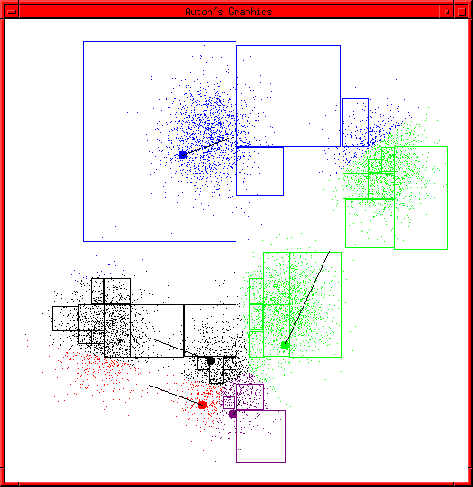
K-means Start
Advance apologies: in Black and White this example will deteriorate
Example generated by Dan Pelleg’s super-duper fast K-means system:
  Dan Pelleg and Andrew Moore. Accelerating Exact k-means Algorithms with Geometric Reasoning. Proc. Conference on Knowledge Discovery in Databases 1999, (KDD99) (available on www.autonlab.org/pap.html)
Copyright © 2001, 2004, Andrew W. Moore

Slide 12
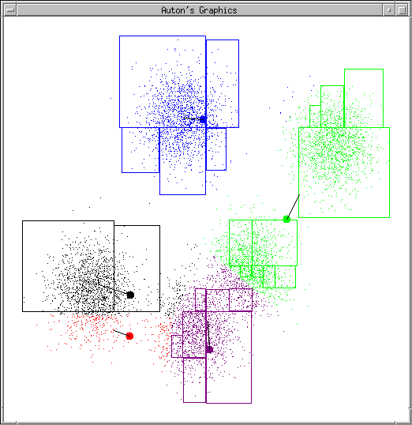
K-means continues…
Copyright © 2001, 2004, Andrew W. Moore

Slide 13
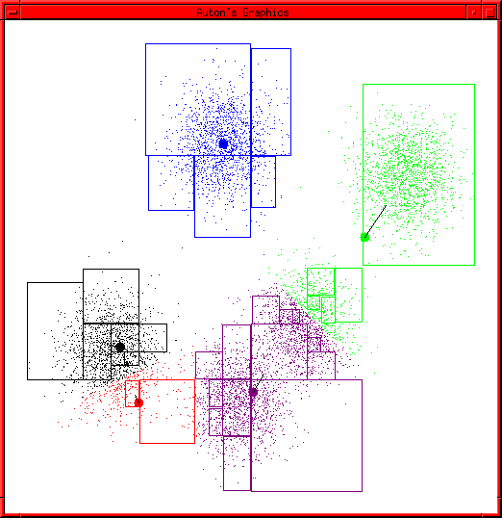
K-means continues…
Copyright © 2001, 2004, Andrew W. Moore

Slide 14
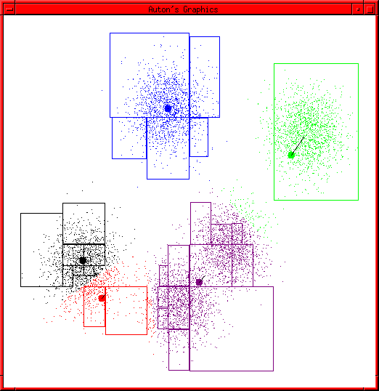
K-means continues…
Copyright © 2001, 2004, Andrew W. Moore

Slide 15
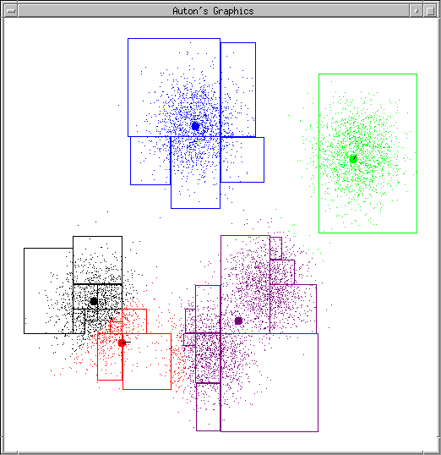
K-means continues…
Copyright © 2001, 2004, Andrew W. Moore

Slide 16
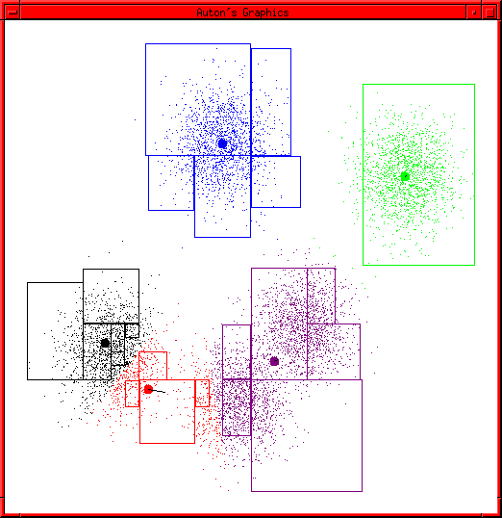
K-means continues…
Copyright © 2001, 2004, Andrew W. Moore

Slide 17
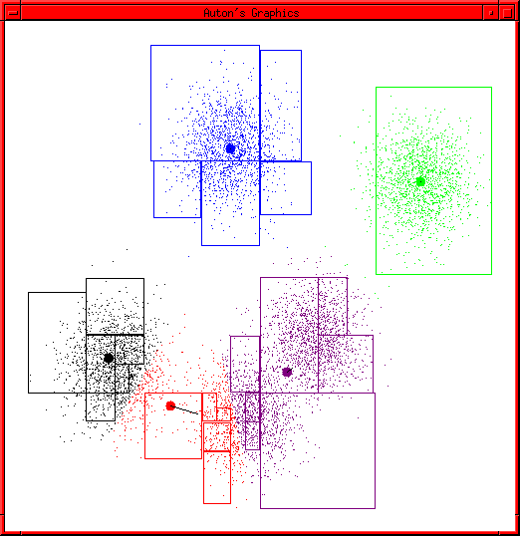
K-means continues…
Copyright © 2001, 2004, Andrew W. Moore

Slide 18
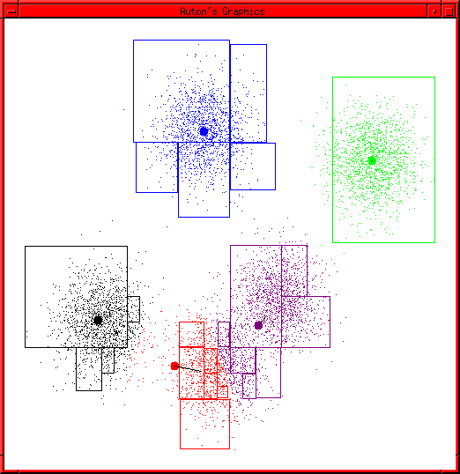
K-means continues…
Copyright © 2001, 2004, Andrew W. Moore

Slide 19
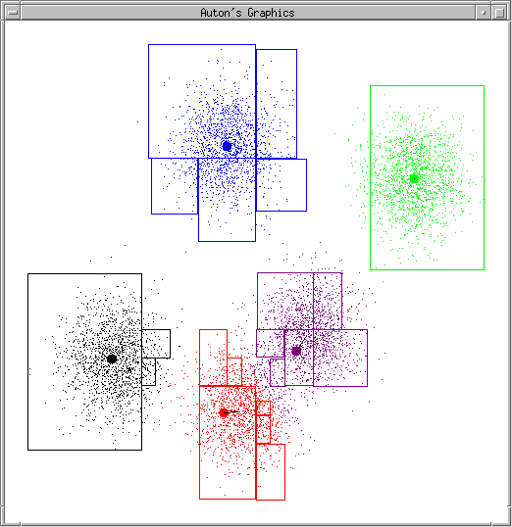
K-means continues…
Copyright © 2001, 2004, Andrew W. Moore

Slide 20
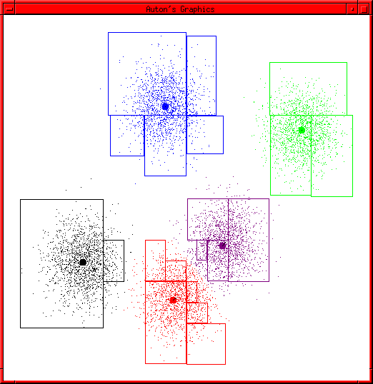
K-means terminates
Copyright © 2001, 2004, Andrew W. Moore

Slide 21
K-means Questions
What is it trying to optimize?
Are we sure it will terminate?
Are we sure it will find an optimal clustering?
How should we start it?
How could we automatically choose the number of centers?
….we’ll deal with these questions over the next few slides
Copyright © 2001, 2004, Andrew W. Moore

Slide 22
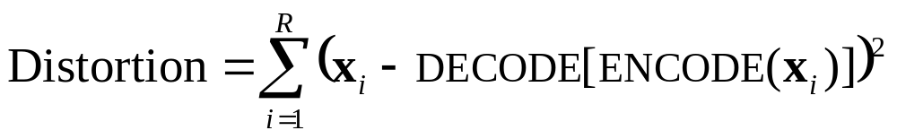
Distortion
Given..
an encoder function: ENCODE : ℜ^{m} → [1..k]
a decoder function: DECODE : [1..k] → ℜ^{m}
Define…
Copyright © 2001, 2004, Andrew W. Moore

Slide 23
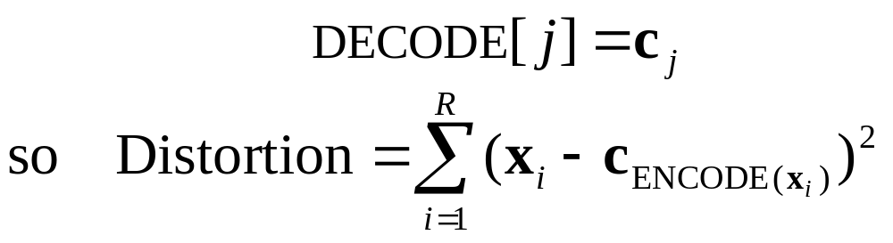
Distortion
Given..
an encoder function: ENCODE : ℜ^{m} → [1..k]
a decoder function: DECODE : [1..k] → ℜ^{m}
Define…
We may as well write
Copyright © 2001, 2004, Andrew W. Moore

Slide 24
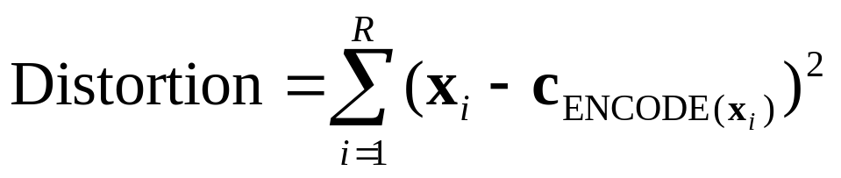
The Minimal Distortion
What properties must centers c₁ , c₂ , … , c_{k} have when distortion is minimized?
Copyright © 2001, 2004, Andrew W. Moore

Slide 25
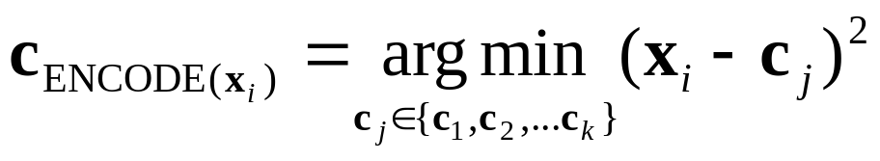
The Minimal Distortion (1)
What properties must centers c₁ , c₂ , … , c_{k} have when distortion is minimized?
(1) x_{i} must be encoded by its nearest center
….why?
..at the minimal distortion
Copyright © 2001, 2004, Andrew W. Moore

Slide 26
The Minimal Distortion (1)
What properties must centers c₁ , c₂ , … , c_{k} have when distortion is minimized?
(1) x_{i} must be encoded by its nearest center
….why?
Otherwise distortion could be reduced by replacing ENCODE[x_{i}] by the nearest center
..at the minimal distortion
Copyright © 2001, 2004, Andrew W. Moore

Slide 27
The Minimal Distortion (2)
What properties must centers c₁ , c₂ , … , c_{k} have when distortion is minimized?
(2) The partial derivative of Distortion with respect to each center location must be zero.
Copyright © 2001, 2004, Andrew W. Moore

Slide 28
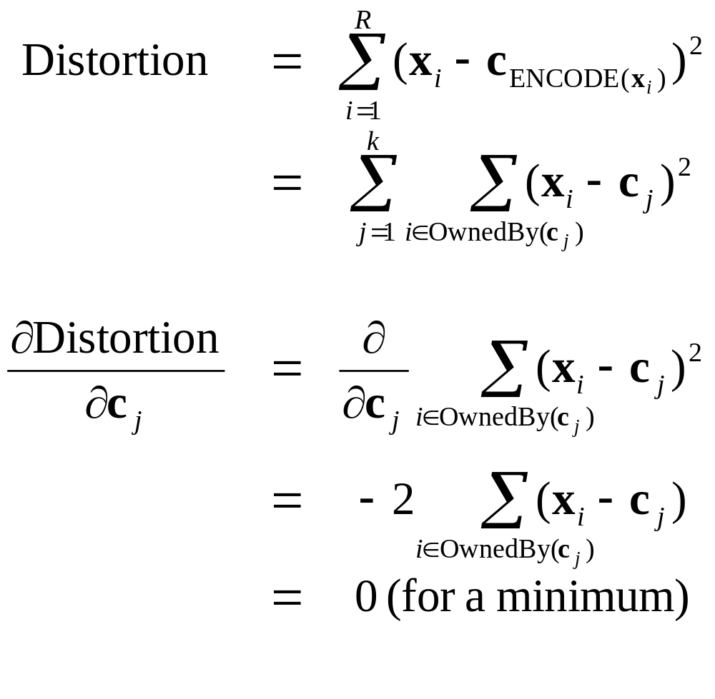
(2) The partial derivative of Distortion with respect to each center location must be zero.
OwnedBy(c_{j} ) = the set of records owned by Center c_{j} .
Copyright © 2001, 2004, Andrew W. Moore

Slide 29
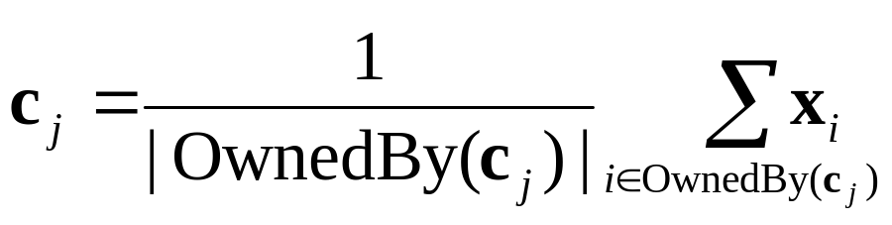
(2) The partial derivative of Distortion with respect to each center location must be zero.
Thus, at a minimum:
Copyright © 2001, 2004, Andrew W. Moore

Slide 30
At the minimum distortion
What properties must centers c₁ , c₂ , … , c_{k} have when distortion is minimized?
(1) x_{i} must be encoded by its nearest center
(2) Each Center must be at the centroid of points it owns.
Copyright © 2001, 2004, Andrew W. Moore

Slide 31
Improving a suboptimal configuration…
What properties can be changed for centers c₁ , c₂ , … , c_{k} have when distortion is not minimized?
(1) Change encoding so that x_{i} is encoded by its nearest center
(2) Set each Center to the centroid of points it owns.
There’s no point applying either operation twice in succession.
But it can be profitable to alternate.
…And that’s K-means!
    Easy to prove this procedure will terminate in a state at which neither (1) or (2) change the configuration. Why?
Copyright © 2001, 2004, Andrew W. Moore

Slide 32
Improving a suboptimal configuration…
There are only a finite number of ways of partitioning R records into k groups.
So there are only a finite number of possible configurations in which all Centers are the centroids of the points they own.
If the configuration changes on an iteration, it must have improved the distortion.
So each time the configuration changes it must go to a configuration it’s never been to before.
So if it tried to go on forever, it would eventually run out of configurations.
What properties can be changed for centers c₁ , c₂ , … , c_{k} have when distortion is not minimized?
(1) Change encoding so that x_{i} is encoded by its nearest center
(2) Set each Center to the centroid of points it owns.
There’s no point applying either operation twice in succession.
But it can be profitable to alternate.
…And that’s K-means!
    Easy to prove this procedure will terminate in a state at which neither (1) or (2) change the configuration. Why?
Copyright © 2001, 2004, Andrew W. Moore

Slide 33
Will we find the optimal configuration?
Not necessarily.
Can you invent a configuration that has converged, but does not have the minimum distortion?
Copyright © 2001, 2004, Andrew W. Moore

Slide 34
Will we find the optimal configuration?
Not necessarily.
Can you invent a configuration that has converged, but does not have the minimum distortion? (Hint: try a fiendish k=3 configuration here…)
Copyright © 2001, 2004, Andrew W. Moore

Slide 35
Will we find the optimal configuration?
Not necessarily.
Can you invent a configuration that has converged, but does not have the minimum distortion? (Hint: try a fiendish k=3 configuration here…)
Copyright © 2001, 2004, Andrew W. Moore

Slide 36
Trying to find good optima
Idea 1: Be careful about where you start
Idea 2: Do many runs of k-means, each from a different random start configuration
Many other ideas floating around.
Copyright © 2001, 2004, Andrew W. Moore

Slide 37
Trying to find good optima
Idea 1: Be careful about where you start
Idea 2: Do many runs of k-means, each from a different random start configuration
Many other ideas floating around.
Neat trick:
Place first center on top of randomly chosen datapoint.
Place second center on datapoint that’s as far away as possible from first center
:
Place j’th center on datapoint that’s as far away as possible from the closest of Centers 1 through j-1
:
Copyright © 2001, 2004, Andrew W. Moore

Slide 38
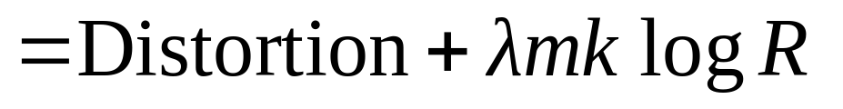
Choosing the number of Centers
A difficult problem
Most common approach is to try to find the solution that minimizes the Schwarz Criterion (also related to the BIC)
m=#dimensions
k=#Centers
R=#Records
Copyright © 2001, 2004, Andrew W. Moore

Slide 39
Common uses of K-means
Often used as an exploratory data analysis tool
In one-dimension, a good way to quantize real-valued variables into k non-uniform buckets
Used on acoustic data in speech understanding to convert waveforms into one of k categories (known as Vector Quantization)
Also used for choosing color palettes on old fashioned graphical display devices!
Copyright © 2001, 2004, Andrew W. Moore

Slide 40
Single Linkage Hierarchical Clustering
Say “Every point is its own cluster”
Copyright © 2001, 2004, Andrew W. Moore

Slide 41
Single Linkage Hierarchical Clustering
Say “Every point is its own cluster”
Find “most similar” pair of clusters
Copyright © 2001, 2004, Andrew W. Moore

Slide 42
Single Linkage Hierarchical Clustering
Say “Every point is its own cluster”
Find “most similar” pair of clusters
Merge it into a parent cluster
Copyright © 2001, 2004, Andrew W. Moore

Slide 43
Single Linkage Hierarchical Clustering
Say “Every point is its own cluster”
Find “most similar” pair of clusters
Merge it into a parent cluster
Repeat
Copyright © 2001, 2004, Andrew W. Moore

Slide 44
Single Linkage Hierarchical Clustering
Say “Every point is its own cluster”
Find “most similar” pair of clusters
Merge it into a parent cluster
Repeat
Copyright © 2001, 2004, Andrew W. Moore

Slide 45
Single Linkage Hierarchical Clustering
How do we define similarity between clusters?
Minimum distance between points in clusters (in which case we’re simply doing Euclidian Minimum Spanning Trees)
Maximum distance between points in clusters
Average distance between points in clusters
Say “Every point is its own cluster”
Find “most similar” pair of clusters
Merge it into a parent cluster
Repeat…until you’ve merged the whole dataset into one cluster
You’re left with a nice dendrogram, or taxonomy, or hierarchy of datapoints (not shown here)
Copyright © 2001, 2004, Andrew W. Moore

Slide 46
Single Linkage Comments
Also known in the trade as Hierarchical Agglomerative Clustering (note the acronym)
It’s nice that you get a hierarchy instead of an amorphous collection of groups
If you want k groups, just cut the (k-1) longest links
There’s no real statistical or information-theoretic foundation to this. Makes your lecturer feel a bit queasy.
Copyright © 2001, 2004, Andrew W. Moore

Slide 47
What you should know
All the details of K-means
The theory behind K-means as an optimization algorithm
How K-means can get stuck
The outline of Hierarchical clustering
Be able to contrast between which problems would be relatively well/poorly suited to K-means vs Gaussian Mixtures vs Hierarchical clustering
Copyright © 2001, 2004, Andrew W. Moore

